Slide 1
Queues and message based architecture

Slide 2
What is a queue?
Infinite loaf of bread
Maybe an infinite bread bin with a finite amount of bread

Slide 3
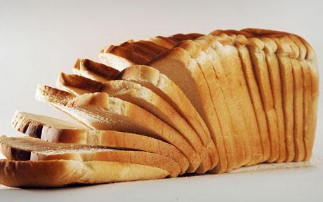
Bread?
Make bread
Eat bread

Slide 4
Oh bread.
Each slice of bread is a slice of data

Slide 5
I don’t have any bread
Okay, so put some other things in the queue
Tasks
Messages

Slide 6
Messages
CreateUser
ID
First Name
Last Name
Email Address
Phone Number
….

Slide 7
Queue methods
Push/Put/Add
Pop/Get
Peek (not in all queues, try to avoid)

Slide 8
In process queues
Let’s look at some code
Things to look out for
Producers
Consumers
Blocking vs. non-blocking queue

Slide 9
Out of process queues
There are a million queues out there
MSMQ
RabbitMQ
ZeroMQ
WebSphere MQ
BizTalk (mumble, mumble)

Slide 10
msmq
Let’s look at some code
Things to look out for
Multiple producers
Multiple consumers

Slide 11
Cloud queues
Azure Queues
Amazon Simple Queue Service

Slide 12
Properties of queues
Durability
Speed
Reliability

Slide 13
Durability
Messages are written to persistent store
Recoverable in the event of power outage

Slide 14
Reliability
Messages are delivered at least once
In many queues messages can be delivered more than once
Distributed transaction support

Slide 15
Speed
Thousands of messages a second can be processed
Doesn’t encounter the trashing issues common with web services
Not as fast as just calling methods
Some queues allow for batching

Slide 16
Scalability vs. Web services
Requests Served
Incoming Requests

Slide 17
Different messaging patterns

Slide 18
Fire and forget
?
Request

Slide 19
Request and response
Respond
Request

Slide 20
Publish and subscribe
Subscriber
Subscriber
Subscriber
Publisher

Slide 21
Building your application with messages
Creates a well defined API
Promotes low coupling
Easy to scale
Easy to swap components
Creates great extensibility points
Language and technology agnostic
Easy to add in new functionality

